Slide 1
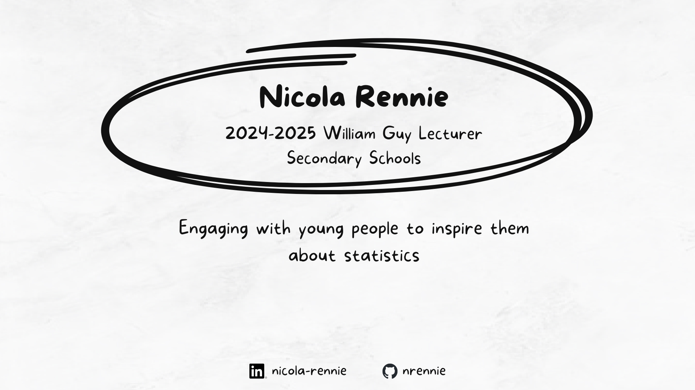

Slide 2

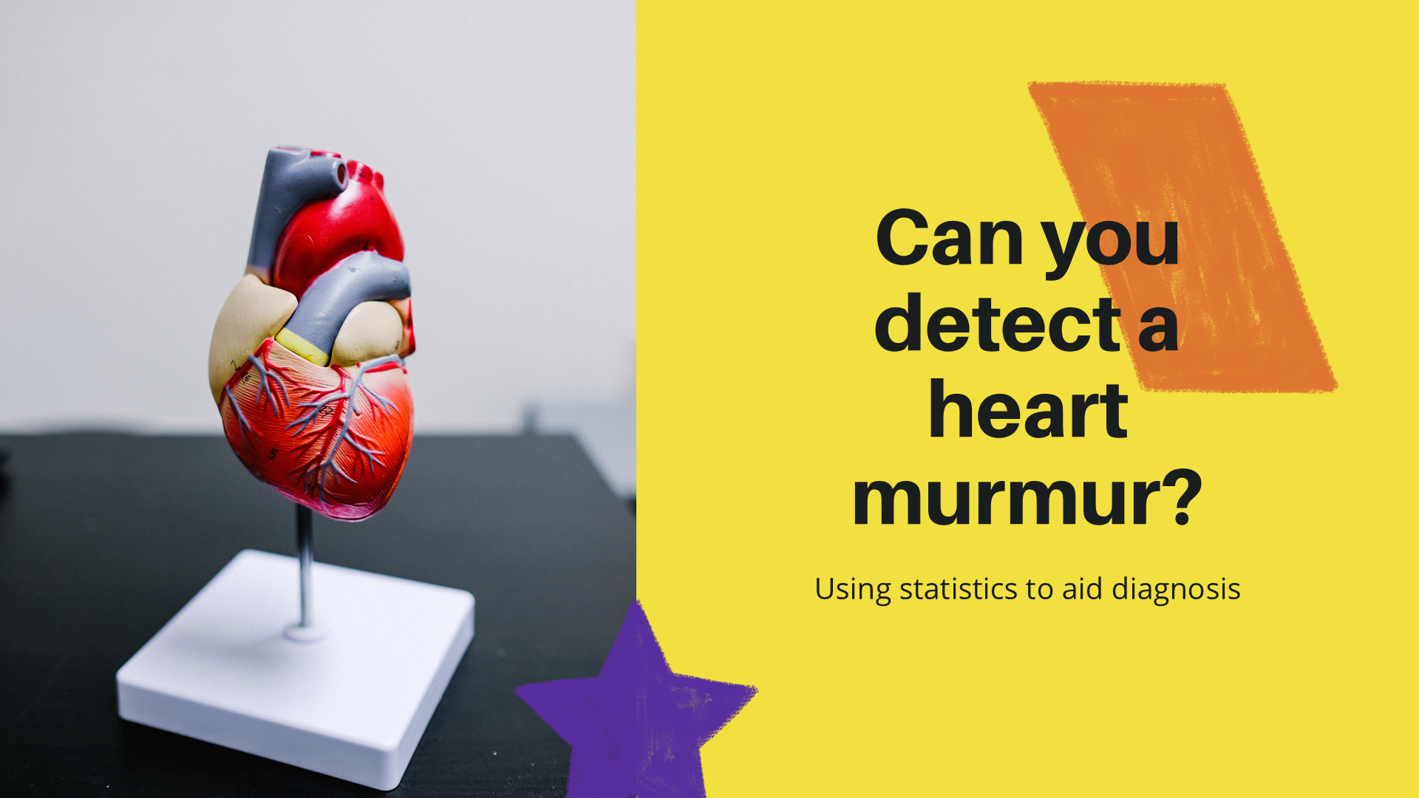
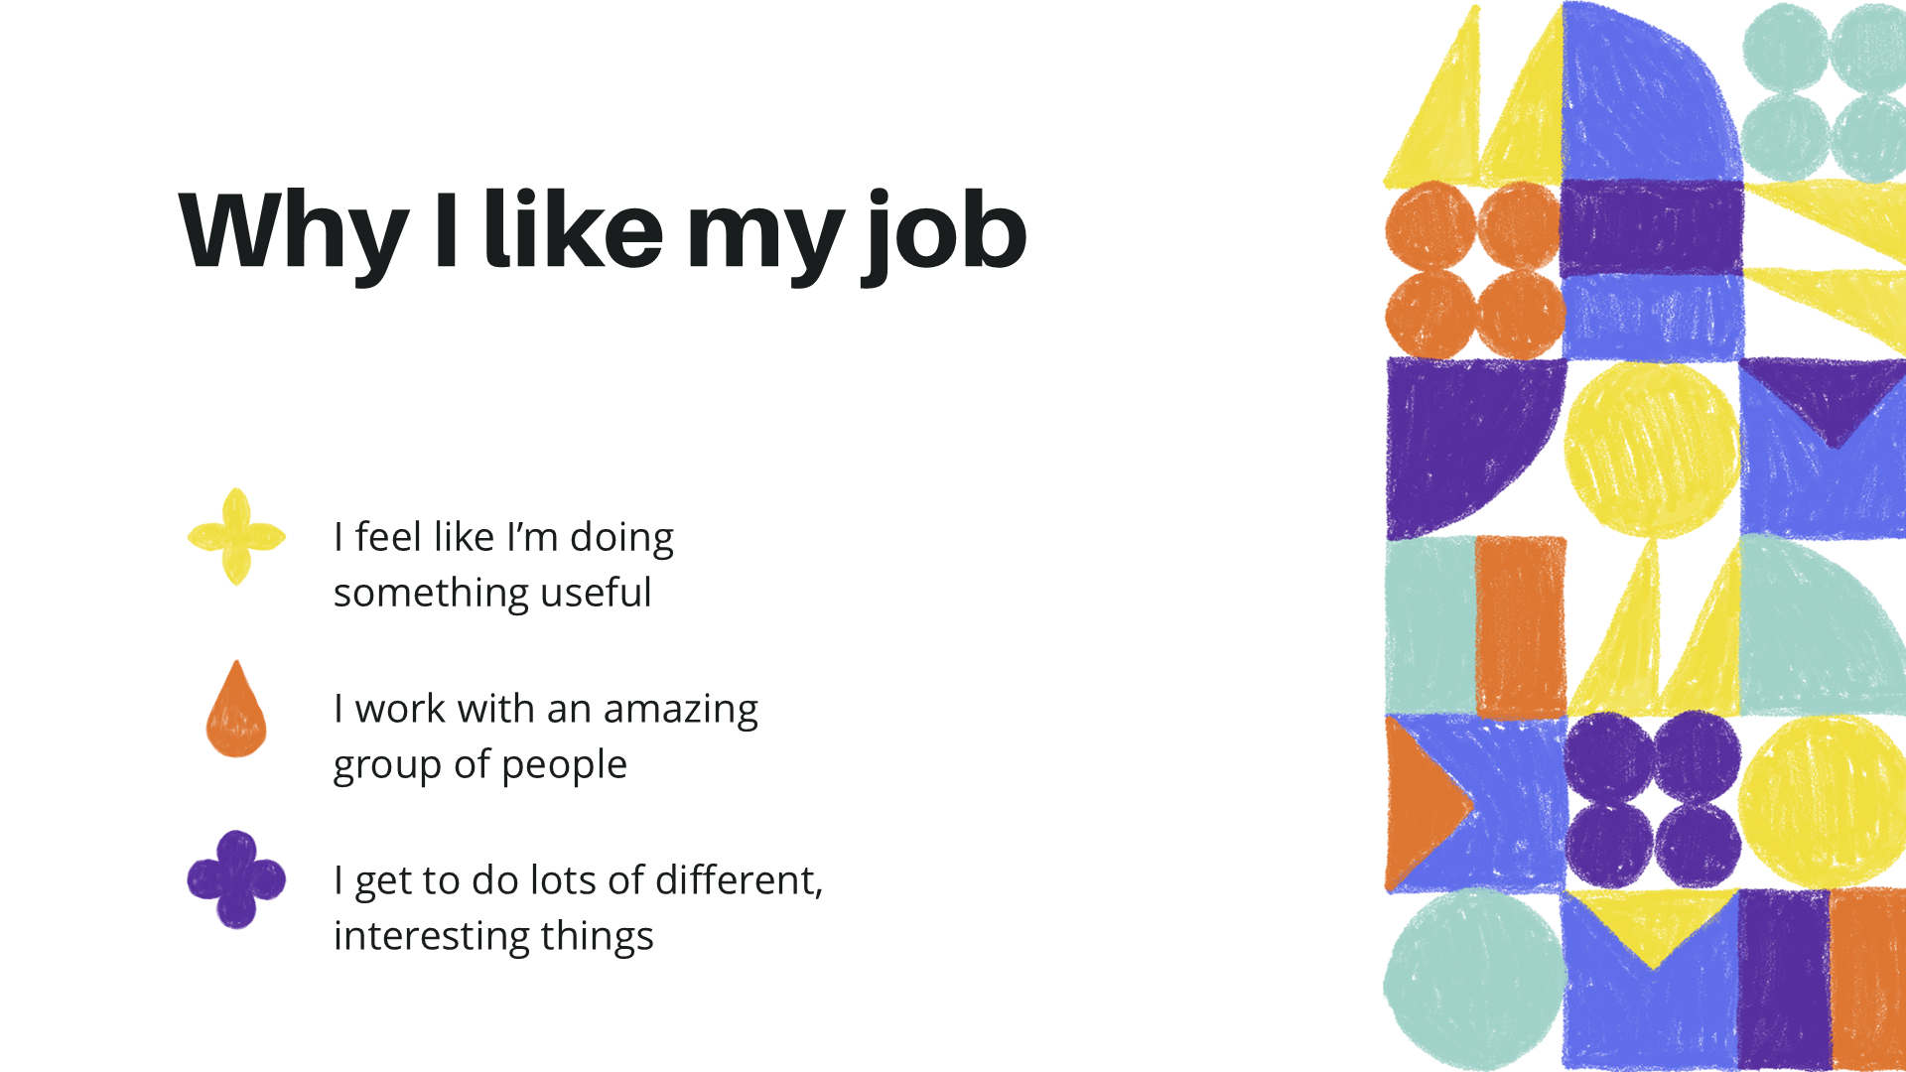
Mainly working with students aged 14-16.
Starting to think about careers.
Focus on encouraging underrepresented groups into careers in data e.g. girls and students from more deprived areas.
Focus on the social good of statistics careers.
Statistics and data science is a viable career path.
Joint events for students and parents.
Project-based workshops showing the end-to-end process of a data science project.

Slide 3

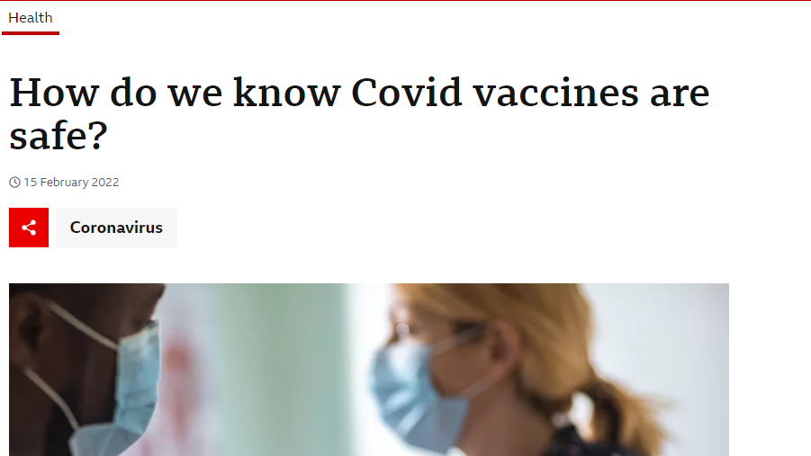
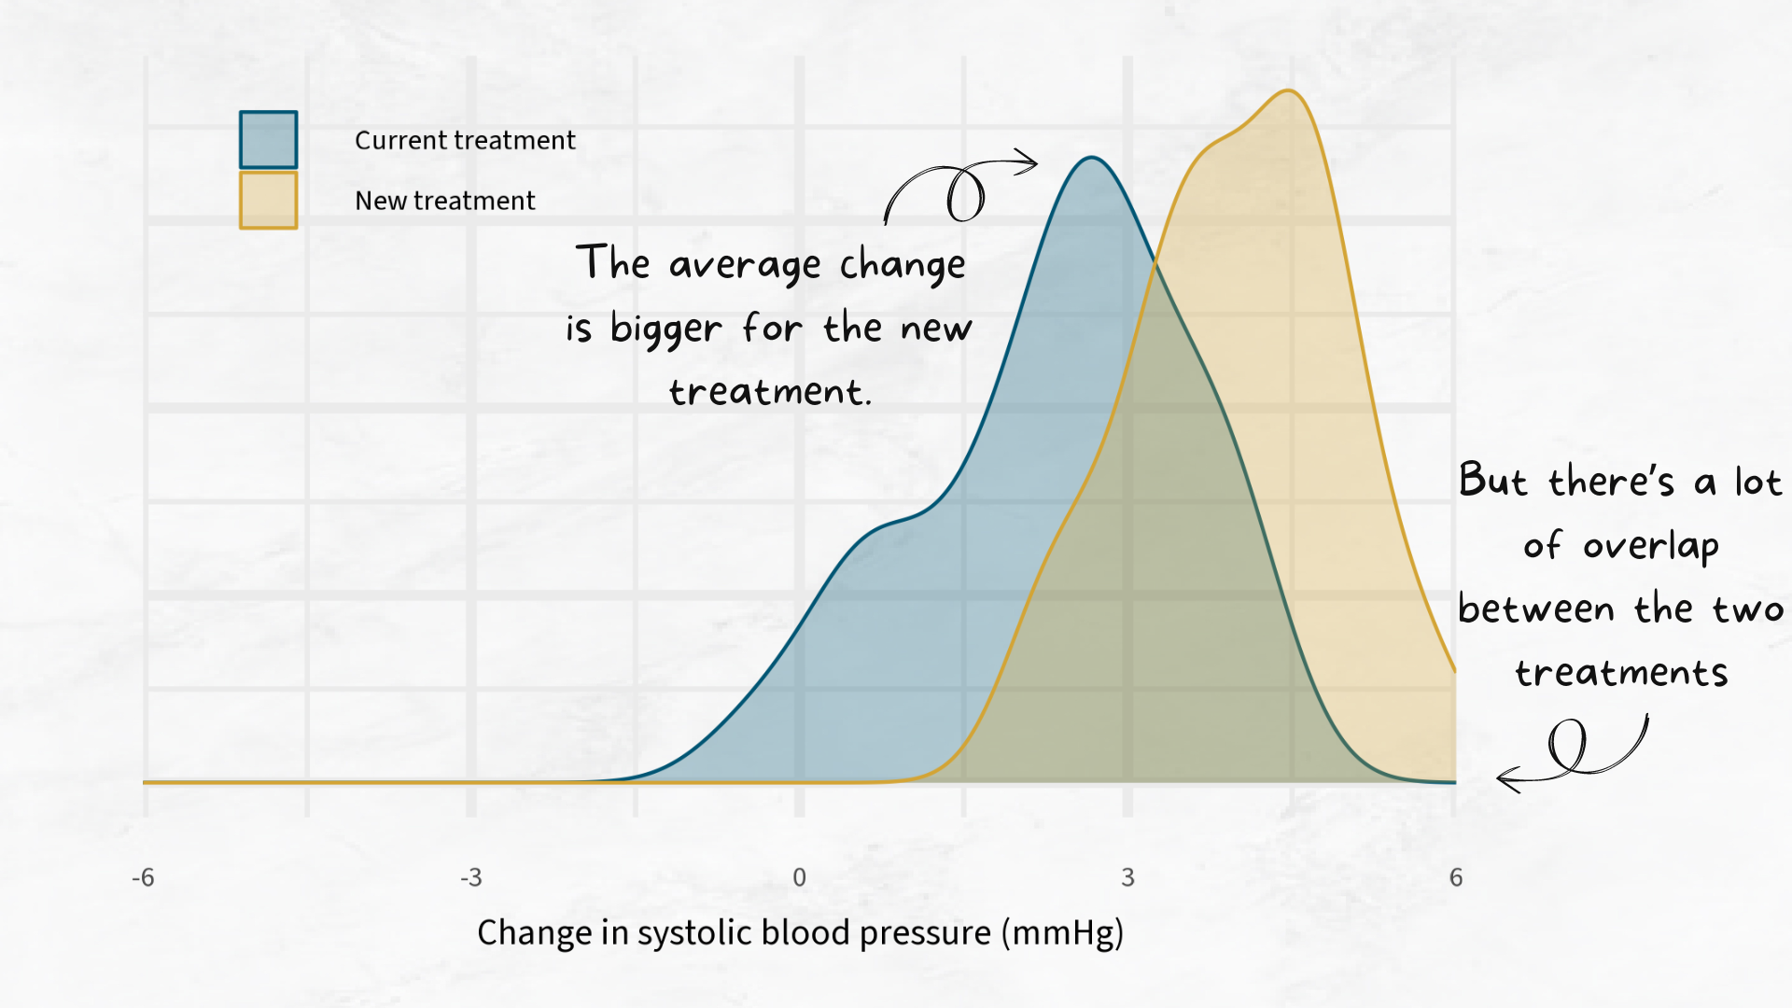
“From lab to patient: how statistics shapes decisions in medical treatment” aimed at students aged 11-16.
The 11-16 age group is when young people typically start making more of their own medical decisions.
Drawing parallels between the questions they might ask about their own health and medical treatment, and the questions that statisticians can worked on:
How do I know this medicine is safe?
How do I know this medicine will work?
How do I know how much I should take?

